Slide 1
Big Data Management (Surveillance Drone Cloud)

Slide 2

DATABASES
MongoDB (NoSQL Database)
IoT data/Images/Videos/Map
Drone data
(Real time drone tracking & availability)
Amazon S3
Store
&
Retrieve data
MySQL (Relational DB)
User Profiles
&
Transactions Management
(service oriented records)

Slide 3




Image
id user_id image_url location_id drone_id Building_id timestamp drone_lon drone_lat altitude camera_device_id service_id | Img_id Int Int int Int int Date Double Double Int int Int
Trip search index
building_id user_id drone_id timestamp path_id service_id | Int Int Int Date Int int
Flight Tracking record
Id User_id Altitude Velocity Direction Camera_angle Drone_lon Drone_lat altitude Building_id Drone_id Timestamp service_id | object_id int int int int int double double int int int date int
Image, video search index
user_id drone_id service_id timestamp drone_lon drone_lat altitude Building_id | Int Int Int Date Double Double int int
Flight Tracking Search Index
building_id user_id drone_id service_id timestamp drone_lon drone_lat altitude | Int Int Int Int Date Double Double int
trip
Id building_id user_id drone_id timestamp path_id service_id | Trip_id Int Int Int Date Int int
Video
Id User_id Video_url Timestamp Start_time Duration Drone_id Building_id Drone_lon Drone_lat altitude Camera_device_id service_id | Video_id int int Date Date Date Int Int Double Double int Int int
location
Payload service tracking
Id drone_lon drone_lat altitude | Payload_obj_id Double Double int
Current waypoint
Id Path_id Altitude Lat Lon Next_waypoint distance | Waypoint_id Int Int Double Double Int double
service Tracking Search Index
building_id user_id drone_id service_id timestamp drone_lon drone_lat altitude | Int Int Int Int Date Double Double int
Payload service tracking
Id drone_lon drone_lat altitude | Payload_obj_id Double Double int
Actual flight path
Id Planned_path_id building_id user_id drone_id service_id | Actual_path_id Int Int Int Int int
Flight path search index
building_id user_id drone_id timestamp path_id planned_path_id service_id | Int Int Int Date Int Int int
NoSQL

Slide 4
Building Search Index
Building Surveillance Search index
user_id drone_id service_id timestamp building_id drone_lon drone_lat altitude | Int Int Int Date Int Double Double int
Surveillance detection results
Id Anomaly_detection Building_id Timestamp Drone_id service_id User_id | Detection_id Boolean Int Int Date Int int
Surveillance Alerts
Id Building_id Detection_result_id Threat_alert | Alert_id Int Int string
Communication Elements
Communication log
LogID Timestamp Drone ID Message (Text) Sender (e.g., drone, ground control station, operator) Receiver (e.g., drone, ground control station, operator) Message Type Message Status | Int Date/time Int String String String String string
Sending message
Request_id Description Source_id Destination_id | Int String Int int
Receiving message
Response_id Description Source_id Destination_id | Int String Int int

Slide 5
Communication
Communication log
LogID Timestamp Drone ID Message (Text) Sender (e.g., drone, ground control station, operator) Receiver (e.g., drone, ground control station, operator) Message Type Message Status | Int Date/time Int String String String String string
Sending message
Request_id Description Source_id Destination_id | Int String Int int
Receiving message
Response_id Description Source_id Destination_id | Int String Int int

Slide 6
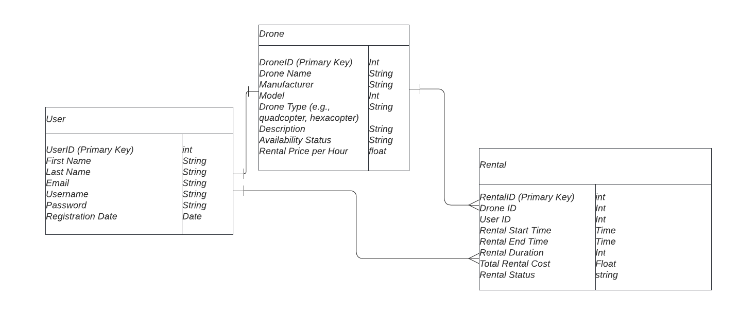
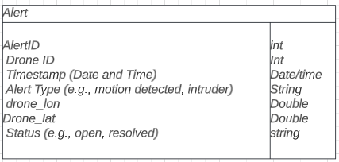
Relational DB

Slide 7
UAV Big Data Classification
IOT DB
Audio DB
Image DB & Video DB
Day-Time Data
Night-Time Data
RADAR DB

Slide 8
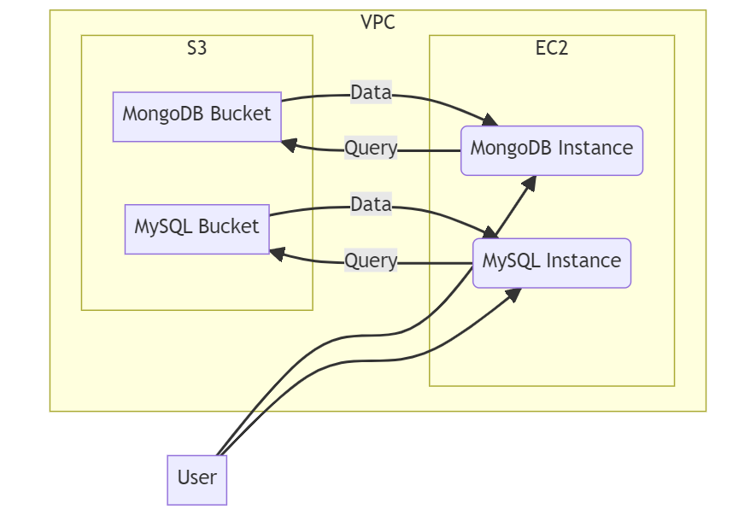
High Level Architecture of Databases

Slide 9
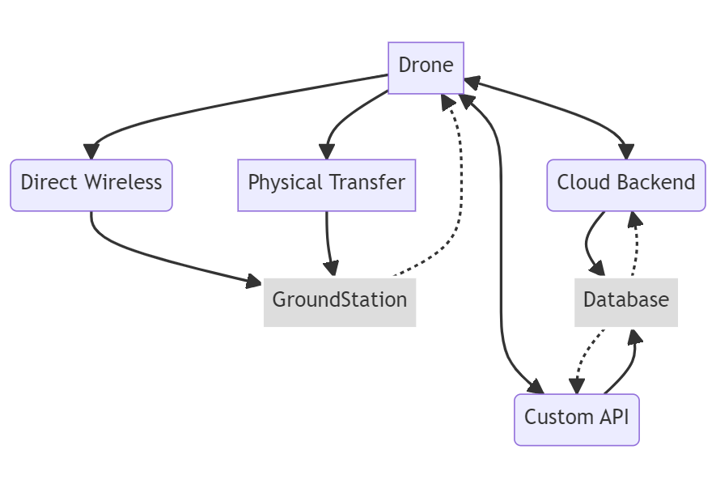
Transmission of Data
.
Prior to flight – DB ----- flight plans, 3D cesium maps, past flight history → Drone
DB receives and stores streams of telemetry data from the drones during flight -- sensor data, GPS coordinates, system diagnostics, etc.
After flight – DB persists – mission images, videos, payload data and flight logs
DB provides no-fly zone updates and other geospatial elements dynamically.

Slide 10
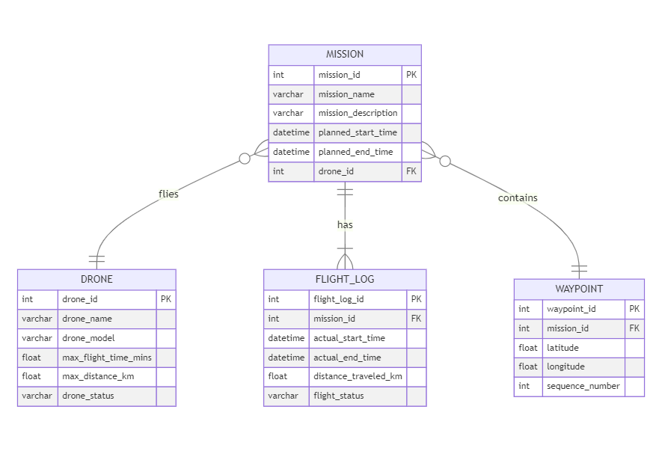
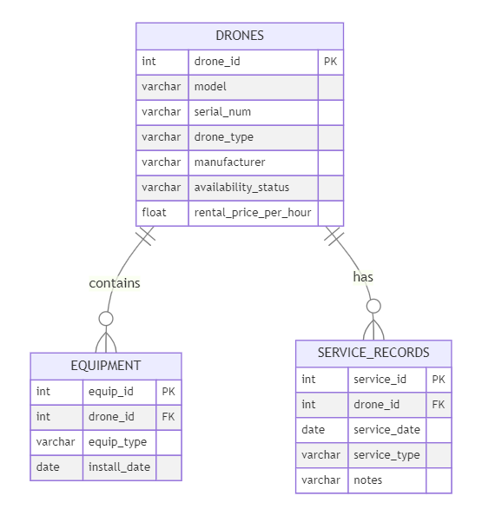
.
Mission Manager and Drone Communication
3 Types of Drone Records

Slide 11
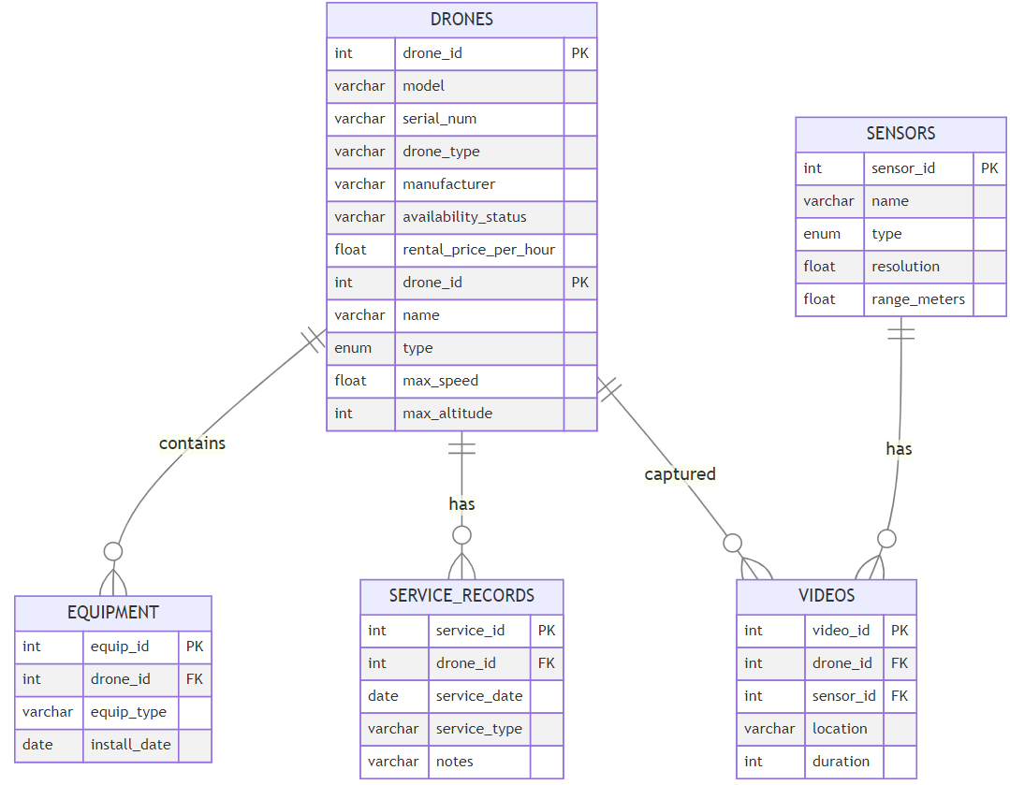
Mysql With Sensor, Drone, Video Type And Profiles

Slide 12
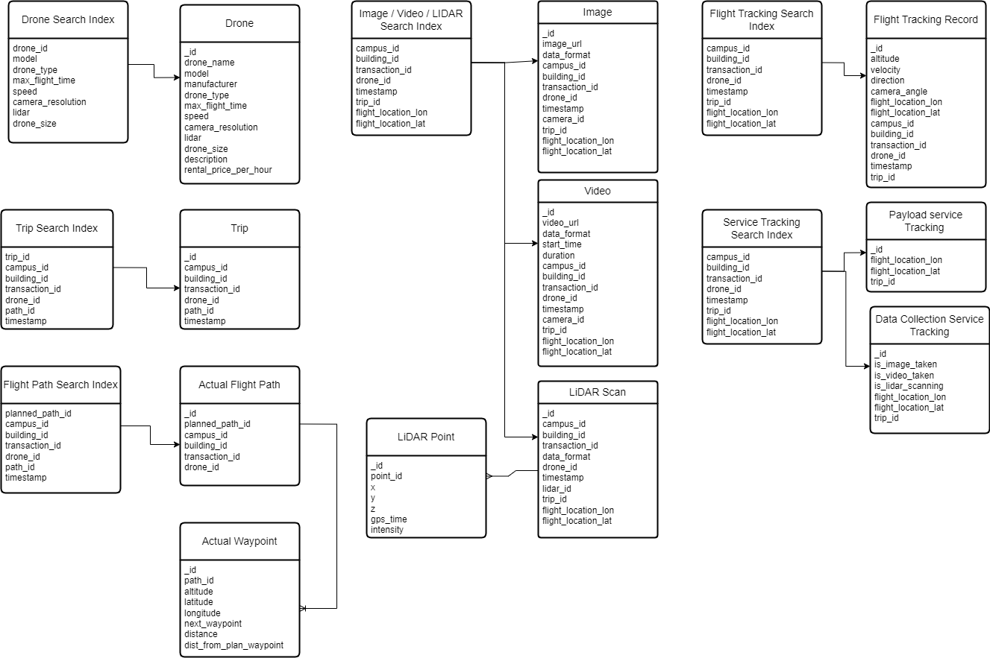
NoSQL Database Schema

Slide 13
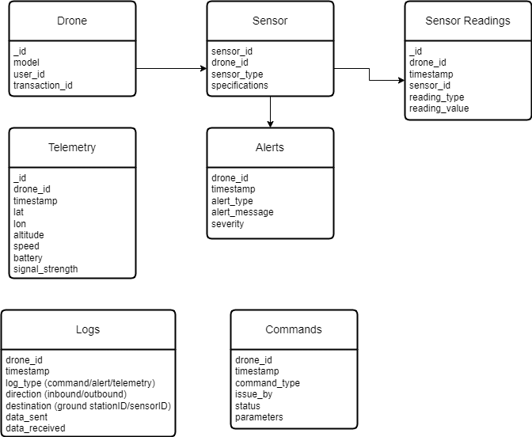
Communication Logs & Sensor Readings

Slide 14
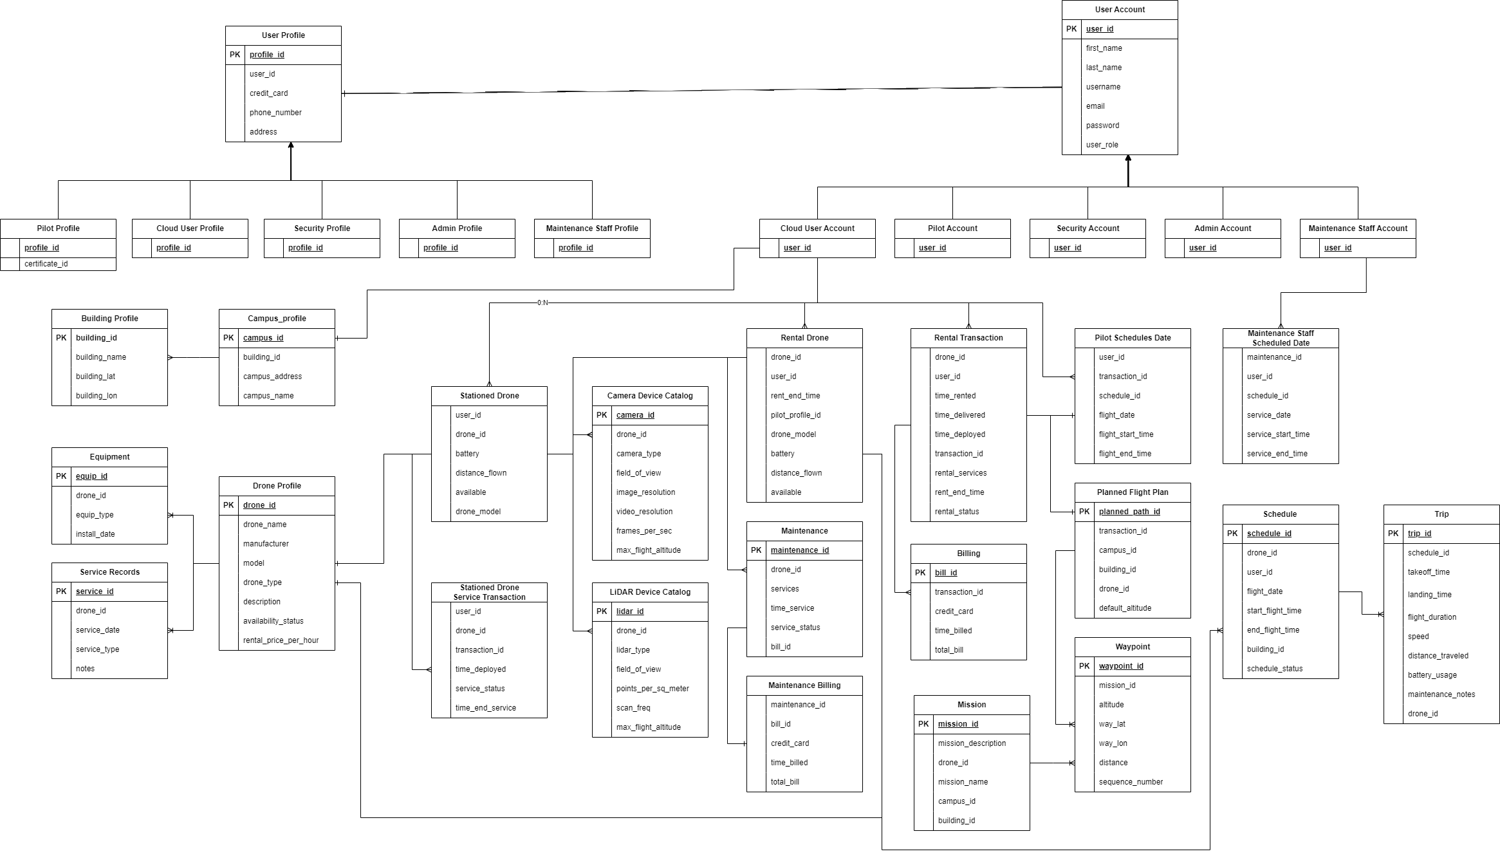
Relational Database Schema

